Slide 1
RTA-SWaT project

Slide 2
Summary
1) Dataset information
2) Data pre-processing
3) Process design schema
4) Open Source tools for our project
5)Model selection

Slide 3
Dataset information
The dataset consists of 13661 samples with 51 attributes which were collected for 6 continuous days. All the data was logged continuously once every second for 136 hours into a Historian server.
Data recorded in the Historian was obtained from the sensors and actuators of the testbed.

Slide 4
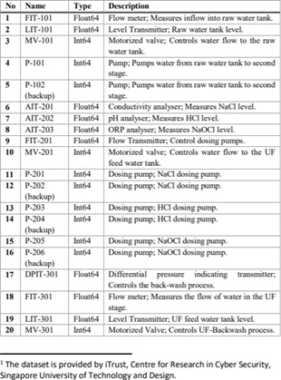
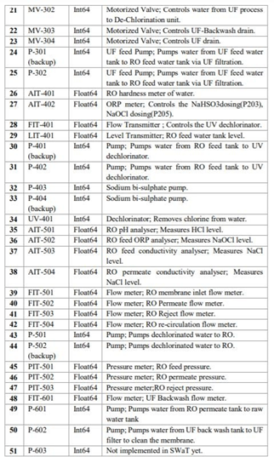
Description of attributes

Slide 5
Data pre-processing
In this process, we dropped 12 columns which consists of one value. So, these atributes does not have effect on final outcome.
The attributes namely :
AIT401, P102, P202, P204, P206, P302, P402, P403, P404, P502, P601, P603

Slide 6
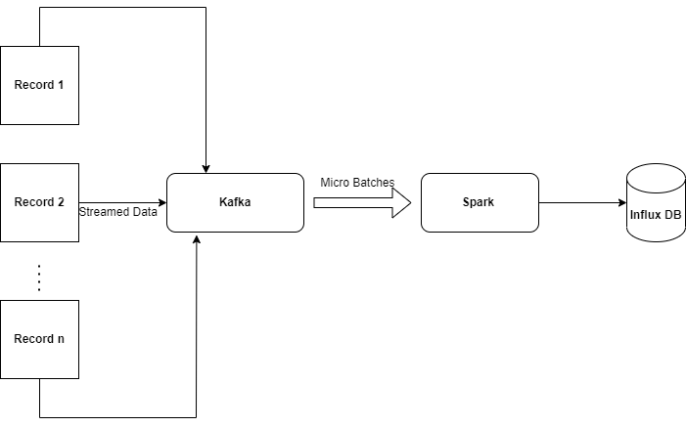
Process design schema

Slide 7
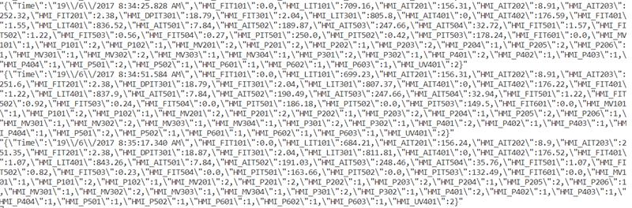
Data published by Kafka

Slide 8



Open Source tools
The frameworks we are about to use are :
Kafka, Spark, Influx DB, and docker to communicate.
Kafka provides guaranteed message delivery with proper ordering.
As the stream data comes continuously and is voluminous, we require a scalable distributed framework. We can use Apache Spark which is fault-tolerant and supports distributed real-time computation systems for processing fast, large streams of data.

Slide 9
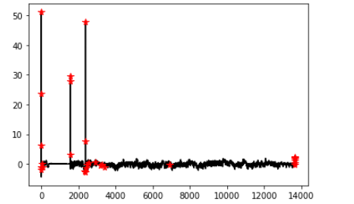
Model selection
In this part, we prefer DBSCAN algorithm to find anomaly dedection.
Because DBSCAN is sensitive to outliers.
But our model can be optimized with hyperparameter-tuning.
Demo result:

Slide 10
Thanks for your attention.
Any question?

